Slide 1

Elements of Systems Architecture
Architecting a complex world
Daniel KROB – CESAMES & INCOSE Fellow
AEIS – September 13, 2021
Elements of systems architecture

Slide 2
Table of contents
0
Introduction
Systems architecture motivations
Systems architecture fundamentals
Systems architecture in practice
Selected new trends in systems architecture
Conclusion
1
1
2
3
4
5
Elements of systems architecture

Slide 3

Brief overview of Daniel Krob’s scientific career
0
2012-: president of CESAMES group
1989-: researcher, then senior researcher in computer science, National Center for Scientific Research (CNRS) – currently laid-off
1997-2002: founding director of the Laboratoire d’Informatique Algorithmique: Fondements & Applications (CNRS & Université Paris 7)
1995-2019: professor, then institute professor, Ecole Polytechnique
2003-2015: founder & director of the Dassault Aviation – DCNS – DGA – Thales industrial chair “Engineering of complex systems” of Ecole Polytechnique
2015-2017: scientific director of SystemX technological institute
2014: fellow of the International Council on Systems Engineering (INCOSE)
Elements of systems architecture

Slide 4
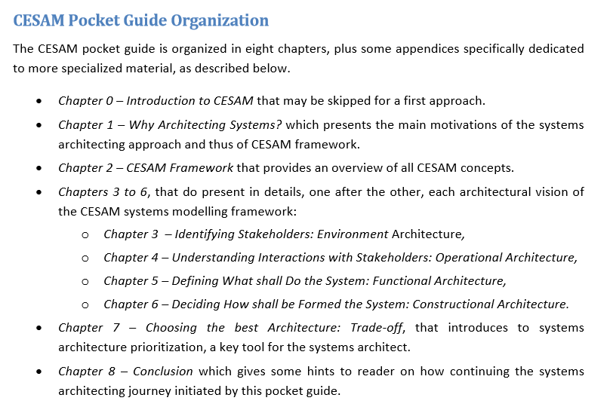
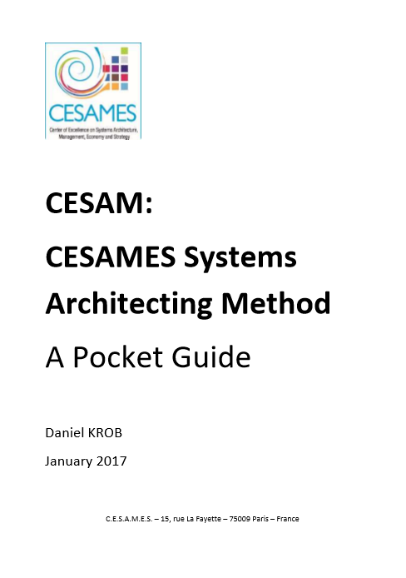
CESAMES public systems architecting methodology
0
https://hal.archives-ouvertes.fr/hal-02561111v2/document
CESAM Level 1: 9,000 trainees
CESAM Level 2: 1,000 senior architects
Deployed in 30 countries
The public CESAMES systems architecting method (CESAM), promoted by CESAMES, can be traced back to NASA and INCOSE systems engineering frameworks.
Elements of systems architecture

Slide 5
Table of contents
0
Introduction
Systems architecture motivations
Systems architecture fundamentals
Systems architecture in practice
Selected new trends in systems architecture
Conclusion
1
1
2
3
4
5
Elements of systems architecture

Slide 6
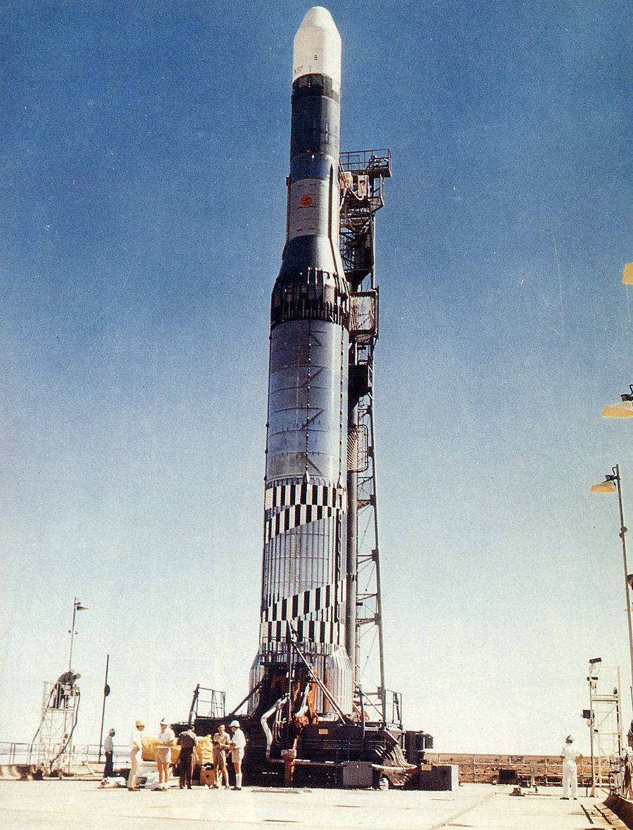

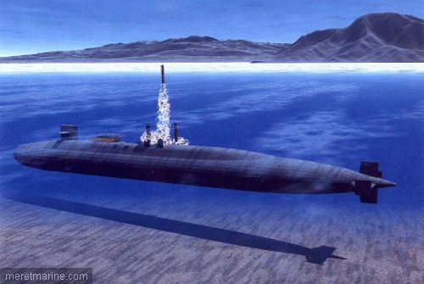


System issue 1 – Addressing critical integration issues
1
First submarine missiles: 1970-1980
Crash due to lack of cooperation between
subsea & air engineering departments
Europa launcher: 1964-1970
No success on 6 attempts due to lack of cooperation between main contributors
Systems engineering is born in 1950-1980 within defense & space as a key tool to solve the critical integration issues of this industry
Elements of systems architecture

Slide 7
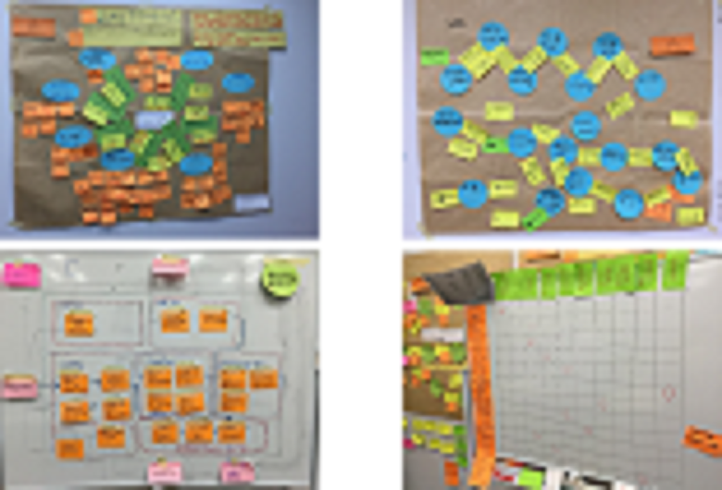
Systems engineering technical answer 1 – Providing explicit system integration models
1
Life cycle
Stakeholders
Functions
Allocation matrix
Examples of collaboratively constructed systems architecture views (for an engineering project in Japan)
Elements of systems architecture

Slide 8
Systems engineering human answer 1 – Introducing systems architect roles
1
Control
The key problem of the “product system”:
INTEGRATION
(i.e. robustness of its technical interfaces )
Mechanics
Product System
Software
Electronics
The key problem
of the “project
system”: CONVERGENCE (i.e. robustness of its human interfaces)
Mechanical engineer
Electronic
engineer
Systems
architect
Control engineer
Software engineer
Project
System
The systems architect is responsible for the integration of the technical systems (i.e. of the technical interfaces) and of the human systems (i.e. he/she has to make the stakeholders of a technical perimeter converge towards a unique vision
Elements of systems architecture

Slide 9
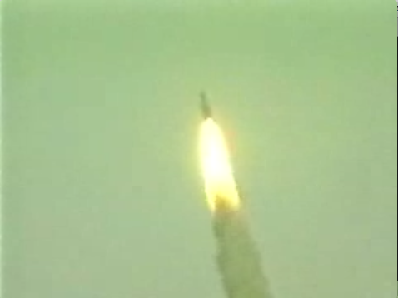
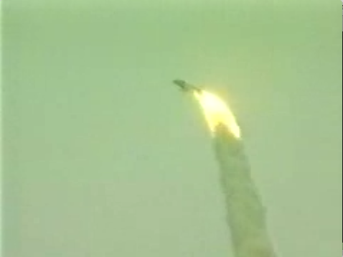

System issue 2 – Undesired emergence (1/2)
1
(1)
(2)
(3)
The crash of June 4, 1996:
  H0-H0+36 s.: perfect flight until second 36 after take-off (1)
  H0+36,7 s.: simultaneous failure of the two inertial systems
  H0+37 s.: activation of the automatic pilot which misunderstood the inertial systems data and corrected brutally the trajectory of Ariane 5 (2)
  H0+39 s.: boosters brake, leading to the launcher self-destruction (3)
Immediate costs of the crash:
  Direct cost: $ 370 m (load lost)
  Induced cost: 1 month of work to recover the most dangerous fragments (e.g. fuel stock) in Guyana swamps (“La Mangrove”)
Huge indirect costs due to Ariane 5 program delaying:
  Ariane 5 second flight was performed one year later
  Ariane 5 first commercial flight was performed 3 years later (December 10,1999)
Elements of systems architecture

Slide 10
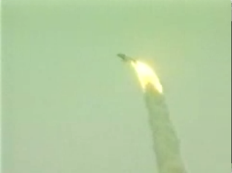

System issue 2 – Undesired emergence (2/2)
1
Source: Lions commission report, 1996
Numerical values of Ariane 5 acceleration (5 times stronger than Ariane 4)
Software components from Ariane 4, re-used without being re-tested in Ariane 5 environment in order to save money (≈ $120.000)
Unexpected values
Automatic pilot
Deflection of the tail pipes of the engine with an angle > 20°
Inertial Reference System (IRS)
Bits signaling the problem
Self-
destruction
IRS1
(principal)
IRS2
(emergency)
Clone of
IRS1
Bits interpreted as flight data
Common-cause logical failure: overflow due to a cast of a « double » into a 16 bits integer
Ironically, the bugged calibration function was useless after
Ariane 5 take-off
H0 + 36s
H0 + 37s
H0 + 39s
The Ariane 5 system was incorrect by design
Elements of systems architecture

Slide 11

Systems engineering answer 2 – Integrating model-oriented verification & validation activities along the design
1
Verification & validation practices can be split into model–oriented and integration-oriented practices.
Integration-oriented V&V
Operational tests
Model validation
Model-oriented V&V
Integrated system validation
Functional & constructional tests
Integrated system verification
Brosse-@-dents électronique
Model verification
Model & integration-oriented verification & validation practices (V&V) are key and shall be used transversally along the design lifecycle of a system.
Elements of systems architecture

Slide 12

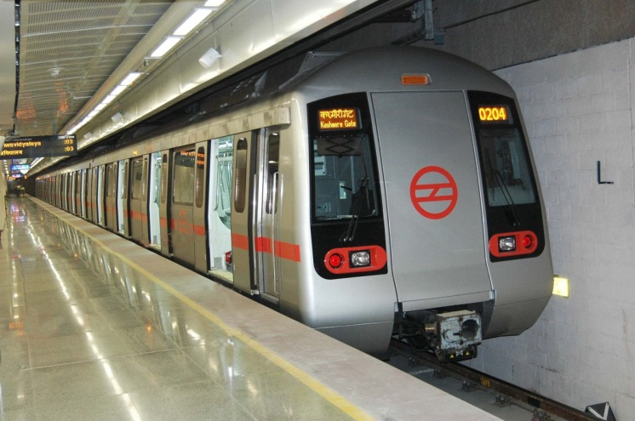
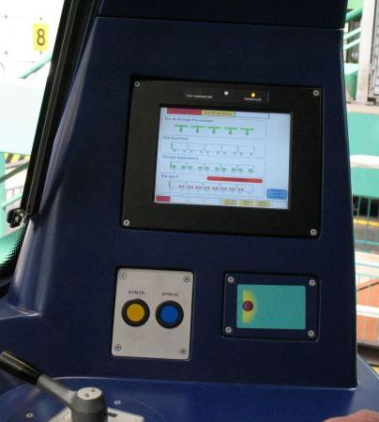
System issue 3 – Missing key stakeholders
The Calcutta subway case (1/2)
1
What happened
  A strong heat wave (45°C = 113°F in the shadow) stroke India during summer
  The cockpit touch screens of Calcutta subway trains became completely white
  The subway stopped operating during a few days (leading to a big chaos)
  The touch screens was immediately retested,
  But they operated fine under high temperature conditions …
Touch screen in the cockpit
The Calcutta subway
Elements of systems architecture

Slide 13
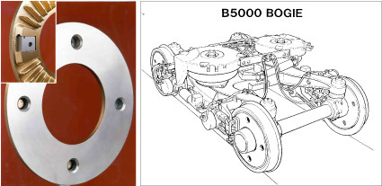
System issue 3 – Missing key stakeholders
The Calcutta subway case (2/2)
1
4
Heat impact: metal expansion → each brake system operates continuously out of its safety borders
Computer tries – unsuccessfully – to bring back all brake systems inside their safety borders
Observed side effect
1
2
Measures
Computer
Bus
Bus
3
Instructions
The network is
overloaded
Touch screen in the cockpit
F
Safety
borders
Computer task: keep each braking system inside its safety borders
Heat impact: the control law is false
Heat: temperature > 45° C
t
The India stakeholder, characterized by summer « high temperature » contexts, was ignored during design: reality is always stronger than documentation
Elements of systems architecture

Slide 14

Systems Engineering Answer 3 – Operational architecture
1
India is a stakeholder of the Calcutta subway
India has summers where temperature can reach 50°C in the shadow
INDIA
Stakeholder & constraint analysis
T > T0 | High temperature special control law
Normal
context
High temperature
context
T < T1 | Normal control law
Lifecycle analysis leads to identify an Indian specific operational context: the « high temperature context »
The system of interest: the Calcutta subway
Operational architecture analyzes the environment of a system that contains all the external systems that may have an influence or an interaction with the system of interest
Elements of systems architecture

Slide 15

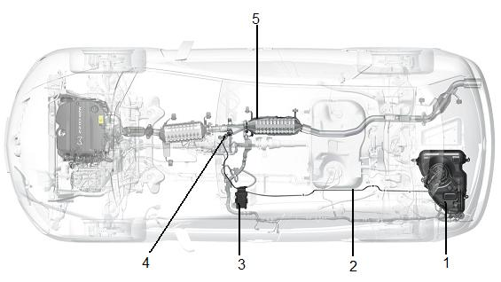
System Issue 4 – Forgetting to manage transversal behaviors
1
Bad gaz
?
Good gaz
Depolluting function
5 Catalyzer
Chassis
resp.
scope
Powertrain
resp.
scope
Injector
Injector
software
Tube
Urea pot
A car constructor wanted to implement a depolluting technology working by urea injection in the engine exhaustion gaz. The depolluting function is cut into two constructional subsets under the powertrain & chassis project responsibilities with nobody in charge of the global coherence of the transverse function. After 5 years of design: a non robust system at the very end plus 5 M€ budget over costs.
Elements of systems architecture

Slide 16
Systems Engineering Answer 4 – Functional architecture (1/3)
1
Inputs
Transverse function
Outputs
Sub-function 1
Sub-function 2
Sub-function 3
Module 1
Module 2
Module 3
Transverse functions are modeling functional cooperation between hardware and software modules and hence indicate where project actors shall collaborate.
Mastering these transverse functions is therefore key!
Elements of systems architecture

Slide 17
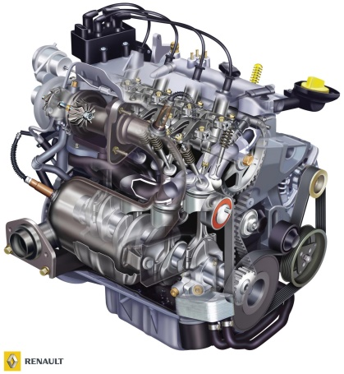
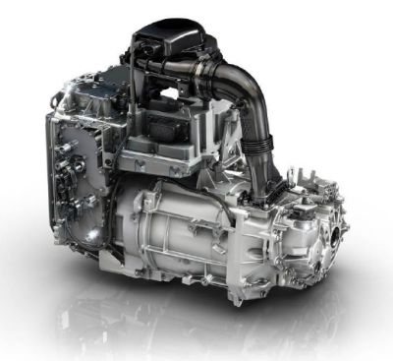
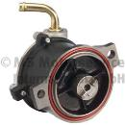
Systems Engineering Answer 4 – Functional architecture (2/3)
1
Provide Energies
Provide Torque
Provide Electricity
Provide Vacuum
Thermic Vehicle
Electric Vehicle
Moreover functions shall be technology independent: they thus provide a stable basis for product design that allows to optimize concrete engineering choices
Elements of systems architecture

Slide 18
Systems Engineering Answer 4 –
Functional architecture (3/3)
1
Legend
Data
Air
Electricity
Mechanics
Layer 3
Software
Components
Layer 3
Software
components
HUAWEI software
OS
Proprietary software
Layer 2
Computing
components
Memory
(11)
Data processing unit
Logical storage unit
CPU
(10)
GPU
RAID card (MEZZ)
(14)
Back
plane
Hard disks
(7)
Hard disk expansion
unit (1)
Main board
(12)
IT server
Layer 1
Support components
Ventilation unit
Chassis
(6)
Logical network unit
Power unit
(4)
Fans
(8)
Heat dissipaters
(3)
Network cards
(2)
Long riser cards (5)
Short riser cards (5)
On board network card (MEZZ) (13)
Air
Data center
Network
Electric network
Note that the stability of a functional architecture also allows to standardize it which may be interesting to design standard structuring interfaces.
Elements of systems architecture

Slide 19
Table of contents
0
Introduction
Systems architecture motivations
Systems architecture fundamentals
Systems architecture in practice
Selected new trends in systems architecture
Conclusion
1
1
2
3
4
5
Elements of systems architecture
Notes:
Ce chapitre commence par une ouverture sur un exemple hors contexte automobile puis revient au contexte automobile.

Slide 20
Key system concept – Time scale and states
2
A time scale T is a totally ordered set with the two following properties:
T has a unique minimal element t₀
each element t ∈ T has a (unique) greatest upper bound within the time scale, called its successor and denoted t+ within T.
Time scales are used to model the moment of times where one can observe a system. Up to rescaling, two types of time scales are key in practice:
discrete time scales where t+ = t + 1,
continuous time scales where t+ = t + dt where dt stands for an infinitesimal quantity.
Discrete time scales model event-oriented systems (such as software systems regulated by a discrete clock) when continuous time scales model physical continuous phenomena.
A state q associated with a time scale T is then just a subset of T, when a state set Q associated with T refers to a partition of T, that is to say a set of states such that:
each moment of time of T is in some state q ∈ Q,
no moment of time of T can be in two different states q ∈ Q.
T
t₀
t₀+
t₀++
…
t
t+
Elements of systems architecture

Slide 21
Key system concept – System (1/2)
2
  Definition 1 – Formal system – Let T be a time scale. A formal system S is characterized on one hand by an input set X, an output set Y and a state set Q associated with T and on the other hand by two kinds of behaviors that link these systemic variables among T :
a functional behavior that produces an output y(t+) ∈ Y at each moment of time t ∈ T, depending on the current input x(t) ∈ X and internal state q(t) ∈ Q of the system,
an internal behavior that results in the evolution q(t+) ∈ Q of the internal state at each moment of time t ∈ T, under the action of a system input x(t) ∈ X.
C
States
(q)
E
Inputs
(x)
Outputs
(y)
S
Resources, data, decisions, pre-conditions, etc.
Internal processings
Deliverables, data, actions, pos-conditions, etc.
Standard representation of the signature of a system
Elements of systems architecture

Slide 22
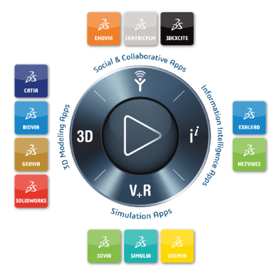

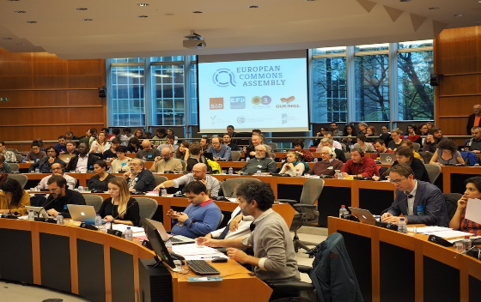
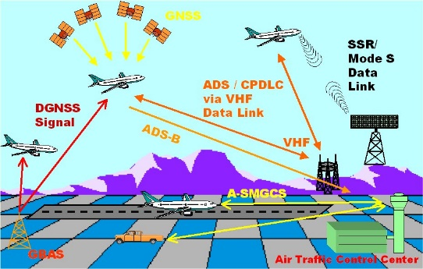
Key system concept – System (2/2)
2
hardware systems (physical laws)
software systems (logical laws)
Everything is a system
”humanware” systems (laws of human behavior)
systems of systems
(interoperability standards)
  Definition 2 – Real system – An object of the real world will be called a real system as soon as its structure and its behavior can be described by a formal system that will be then called a model of the considered real system.
Elements of systems architecture

Slide 23
Key system concept – Integration – First unformal attempt
2
Hardware
systems
Humanware
systems
Father
End-user
Child
System
Software systems
Electronic
toothbrush
Brushing speed
controller module
Brushing analysis
& reporting module
Mother
Integration is the process that allows to build a system based on other systems (hardware, software & humanware) that are organized in such a way that the resulting integrated system can perform – in a given environment – its mission
Elements of systems architecture

Slide 24


Key system concept – Emergence
2
Bricks
An integration of bricks leads to a wall which may have a number of emergent properties
The point is that integration induces emergence which was not captured at all by the previous definition: an integrated system has always emergent properties that cannot be deduced from the properties of the systems with which it is built.
Elements of systems architecture

Slide 25
Key system concept – Abstraction
2
Concrete set
Abstract set
Abstraction
Circle
Rectangle
shape
Concrete objects: colored 2D objects
Abstract objects: shapes
Concretization
Circle
All circles
Circle
Abstraction(Concretization(A)) ⊆ A
C ⊆ Concretization(Abstraction(C))
Formal definition:
An abstraction is a not (too much) destructive idealization of a set of objects
Source: Abstract interpretation, Cousot & Cousot (1977)
Elements of systems architecture

Slide 26
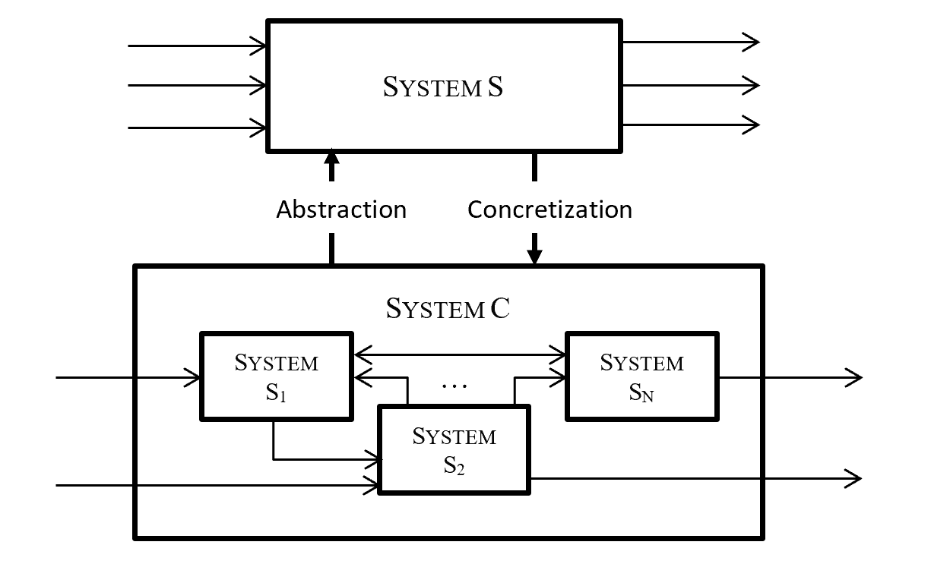
Key system concept – Integration (1/2)
2
  Definition 3 – Integration – Let S₁, … , S_{N} be a set of N (formal) systems. One says then that a (formal) system S is the result of the integration of these systems if there exists on one side a (formal) system C obtained by composition of S₁, …, S_{N} and on the other side dual abstraction and concretization operators that allow to express:
the system S as an abstraction of the system C,
the system C as a concretization of the system S.
Formal integration of systems
Elements of systems architecture

Slide 27
Key system concept – Integration (2/2)
2
  The definition of integration has several immediate important consequences:
  One never obtains a complete model of an integrated system by composing the models of its sub-systems.
  This first property motivates the existence of a specific discipline dedicated to the construction of models of integrated systems which is systems architecting.
  The knowledge of the properties of the sub-systems of a system does not give us the full knowledge of the properties of the system. As a matter of fact, it is much easier to deduce the properties of the sub-systems of a given system from the properties of this system, as far as one knows the integration law.
  This second property motivates to favor a top-down approach for modelling an integrated system.
  Note that in practice, one must take into account bottom-up feedbacks which results in a mixed top-down major and bottom-up minor approach for systems architecting.
  In the integration definition, abstraction applies both on the input / output sets and on the time scales. As a consequence, the systemic hierarchy which is induced by integration is both a time & space abstraction hierarchy.
Elements of systems architecture

Slide 28






Key system concept – Systemic hierarchy
2
Measure of the number of levels
of integration necessary to get
the target integrated system
Measure of the nature of the
systemic features and characteristics which can be manipulated
Systemic
hierarchy
Abstraction
levels
System
Emergent features & characteristics (e.g. duration of an automatic brushing)
System level 0 layer
System
abstraction level
Electronic toothbrush
Integration
System level1 layer
Sub-system(s) abstraction level
Embedded
Software
Integra-
tion
Integra-
tion
Integra-
tion
Integra-
tion
System level 2 layer
Sub-sub-system(s) abstraction level
…
…
Controller
module
Analysis & reporting
module
Etc.
Etc.
Every system can be decomposed according to a systemic hierarchy, which corresponds to its integration levels, but which is also a hierarchy of abstraction levels reflecting the emergent features induced by each integration process
Elements of systems architecture

Slide 29
Table of contents
0
Introduction
Systems architecture motivations
Systems architecture fundamentals
Systems architecture in practice
Selected new trends in systems architecture
Conclusion
1
1
2
3
4
5
Elements of systems architecture

Slide 30
Table of contents
0
Introduction
Systems architecture motivations
Systems architecture fundamentals
Systems architecture in practice
  4.1 – Systems architecture views
  4.2 – Systems architecture framework & process
Selected new trends in systems architecture
Conclusion
1
1
2
3
4
5
Elements of systems architecture
Notes:
Ce chapitre commence par une ouverture sur un exemple hors contexte automobile puis revient au contexte automobile.

Slide 31
Key systems architecture concept – Architectural pyramid
3
Operational
Vision
(Why?)
Which services are to be provided to the environment?
1
Mission
System outside
System Boundary
Function
System inside
Functional
Vision
(What?)
2
Function
Which functions are to be provided?
Function
Function
Constructional
Vision
(How?)
Hardware
Software
Which concrete resources form the system?
3
Humanware
Technical components
We can therefore study any system from three visions
Elements of systems architecture

Slide 32
Why three architectural visions? (1/2)
3
OUTSIDE
Toothbrush company
Dentists
External
systems
Electronic toothbrush
External
interfaces
System
Toothpaste
Base
Internal sub-systems
Head
Embedded
System
End-users
Place of use
Body
INSIDE
External systems
Hardware system
Internal
interfaces
Software system
Humanware system
Maintenance
Internet
Environment
Any system S is a part of its environment Env(S) which is the “smaller” system that encapsulates S and which is supposed without any external interface. To understand how the system S interacts with the other systems of Env(S), one has to model this environment. This activity is classically called the operational architecture of the system S, even if strictly speaking it is the architecture of the environment of S.
Elements of systems architecture

Slide 33
Why three architectural visions? (2/2)
3
Functional
architecture
Constructional
architecture
To describe an integrated system, one must – by definition – describe how its different sub-systems are composed, which correspond to constructional architecture, but also the behavior of the system in its whole, which correspond to functional architecture.
Elements of systems architecture

Slide 34
Relationships between the three architectural visions
Electronic toothbrush example
3
Electronic toothbrush
Electricity
Operational
vision
(analysis of the environment
of the target system)
Power supply
End-users
Queries
Internet
OUTSIDE
Reports
Electricity
Forces
Queries
Measures
Interface
Interface
Interface
Functional
vision
(abstract internal behavioral analysis of the target system)
Provide
electrical power
Generate
brushing force
Measures
Provide
brushing capability
Toothbrush
Electricity
Allocation
Allocation
Allocation
INSIDE
Constructional
vision
(concrete internal structural analysis of the target system)
Holding-force
Brushing force
Electricity
Electricity
Body
Electricity
Embedded
Software
Queries
Measures
Base
Measures
Mechanical Interfaces
Head
Toothbrush
Elements of systems architecture

Slide 35
Table of contents
0
Introduction
Systems architecture motivations
Systems architecture fundamentals
Systems architecture in practice
  4.1 – Systems architecture views
  4.2 – Systems architecture framework & process
Selected new trends in systems architecture
Conclusion
1
1
2
3
4
5
Elements of systems architecture
Notes:
Ce chapitre commence par une ouverture sur un exemple hors contexte automobile puis revient au contexte automobile.

Slide 36
A bit of archeology: Hoare equivalence (1969)
3
With each computable function f, that is say a function that can be computed by a software program, one can associate a logical predicate, called an Hoare assertion, which models the relationships between the pre-conditions and the post-conditions of the computable function f.
Hoare theorem states then that one can equivalently define any computable function:
either in extension by an algorithm,
or in intension by an Hoare assertion.
This theorem is the cornerstone of requirements engineering in software engineering since it states that any function that can be computed by a software can be specified either through an algorithm or through a set of requirements (mathematically a set of requirements can be encoded into a single requirement).
y = add(x): return(x+1)
x = x0 —→ y = x0+1
Example of a computable function
Associated Hoare assertion
Elements of systems architecture

Slide 37
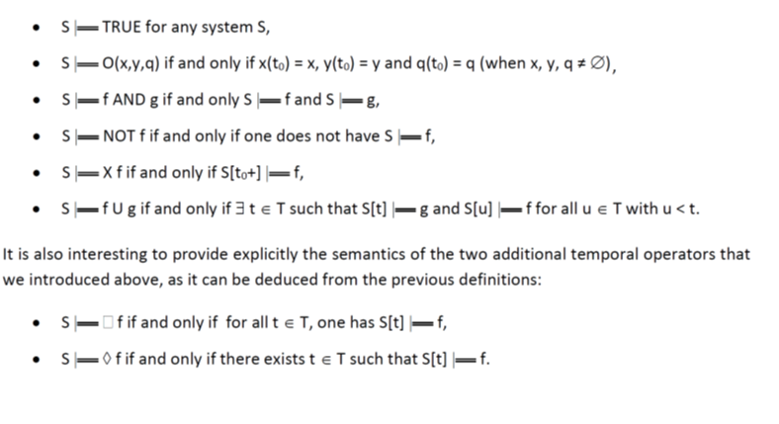
Temporal system logics
3
Mimicking classical results of computability theory, one can associate with any system a temporal system logics defined as follows:
A system requirement is then just any logical property of a system described using such a temporal system logical. A maintainability property can for instance be stated as:
Elements of systems architecture

Slide 38
Systems can be described either in intention or in extension
3
Exactly as in classical computability theory, one can prove that one can describe equivalently a system:
either in intention, using temporal system logic,
or in extension, using an explicit description of the system.
Mathematically these two modes of specifications are equivalent. However their practical complexity is not equivalent at all. As a consequence, any concrete system specification is always a mixture of these two types of specifications.
Requirements
Allocation
Descriptions
Requirement type: the system> shall <do or be something> …
Elements of systems architecture

Slide 39

CESAM systems architecture framework
Generic structure of a description view
3
A system S can
or by an explicit description:
either be specified by requirements
y(t+) = F(x(t),q(t),t)
q(t+) = G(x(t),q(t),t)
Expected features | States | Static elements | Dynamic behaviors | Flows
S |- q -> P
q
F
Y = F_{q}(x)
x, y
Logical modeling
Time modeling
Functional modeling
(signature and “algorithmics”)
“Data” modeling
Generic structure of CESAM framework
Elements of systems architecture

Slide 40
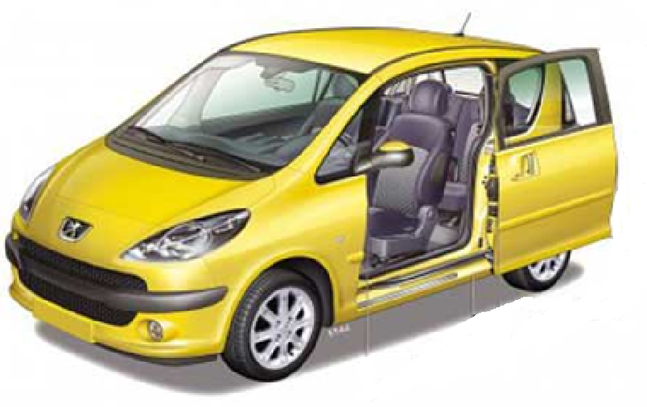
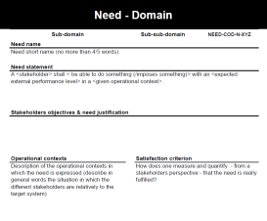
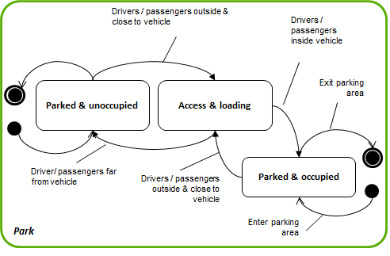
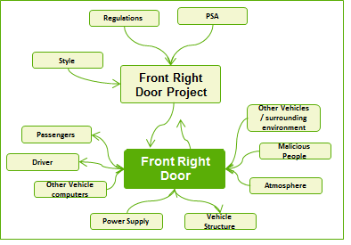
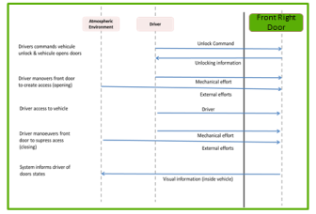
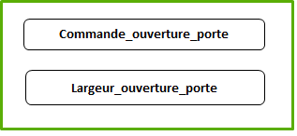
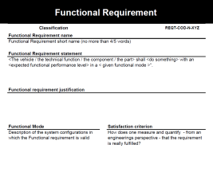
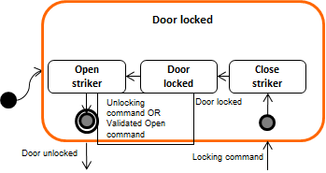
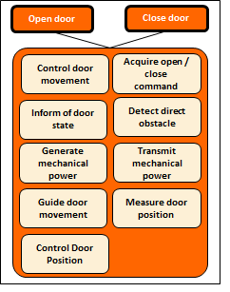
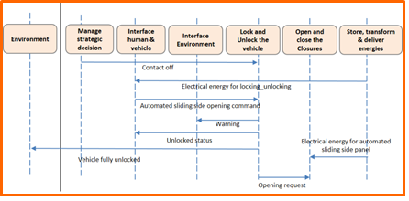
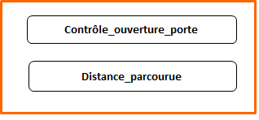
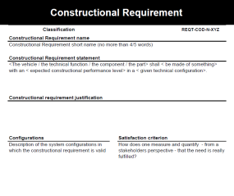
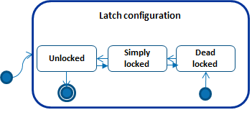
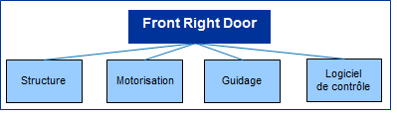
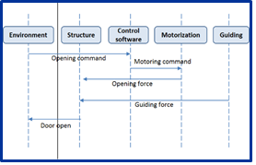
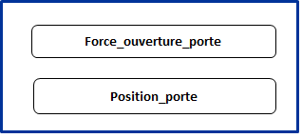
CESAM systems architecture framework
Requirements and descriptions
3
Sliding side door
Requirements
Description
Systems architecture visions | Expected features | States | Static elements | Dynamic behaviors | Flows
Operational vision
Functional vision
Constructional vision
Towards specification files
Generic structure of a systems architecture referential
Elements of systems architecture

Slide 41
CESAM systems architecture framework
Synthesis: the CESAM systems architecture cube
3
An analysis method for any given system
Systemic hierarchy
Constructional vision
Functional vision
System level
Operational vision
Sub-system level
Sub sub system level
Expected features referential
Solution referential
etc.
Needs & requirements
States
Static
elements
Dynamic behaviors
Flows
Behaviors
Architectural visions
Elements of systems architecture

Slide 42
Main steps of the systems architecting process
3
1
Operational architecture
0
3
2
Stakeholder
Analysis
Needs
Architecture
Use case analysis
Lifecycle
analysis
Functional architecture
5
4
6
Functional requirements architecture
Functional interaction & decomposition
Functional modes
8
7
9
Constructional architecture
Constructional requirements architecture
Constructional interaction & decomposition
Technical configurations
10
Prioritization
& trade-offs
analyses
The systems architecting process – which is not sequential at all – consists in moving in the systems architecture cube following a standard way.
Elements of systems architecture

Slide 43
Table of contents
0
Introduction
Systems architecture motivations
Systems architecture fundamentals
Systems architecture in practice
Selected new trends in systems architecture
Conclusion
1
1
2
3
4
5
Elements of systems architecture
Notes:
Ce chapitre commence par une ouverture sur un exemple hors contexte automobile puis revient au contexte automobile.

Slide 44
Table of contents
0
Introduction
Systems architecture motivations
Systems architecture fundamentals
Systems architecture in practice
Selected new trends in systems architecture
  4.1 – Systems of systems engineering
  4.2 – Let us dream a little bit!
Conclusion
1
1
2
3
4
5
Elements of systems architecture
Notes:
Ce chapitre commence par une ouverture sur un exemple hors contexte automobile puis revient au contexte automobile.

Slide 45
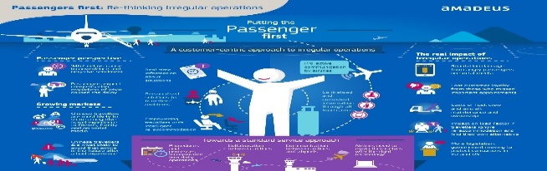
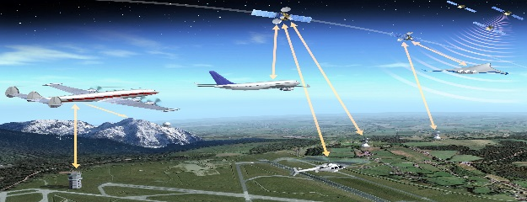

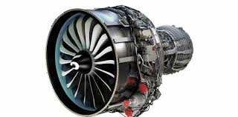
System complexity hierarchy
4
Type of system | Characteristics | Typical example | Design strategy
Ecosystem | Weak coupling of systems of systems |  | Actors influence
System of systems | Weak coupling of distributed systems |  | Interfaces standardization
Product | Strong coupling of fixed components |  | W-cycle
Product component | Does not exist independently of a product |  | V-cycle
Air transportation
Air Traffic Management
Aircraft
Aircraft engine
Components, integrated products, systems of systems and ecosystems are all systems. From a modelling perspective, they can all be modelled using the same formalism.
Elements of systems architecture
Notes:
12/09/2021
45

Slide 46




The difference between systems of systems and usual systems engineering rather relies on specific design issues
4
Distribution
Inter-operability
Competition
Unpredictability
Specific systems of systems features that are difficult to take into account in their design
The main difference between systems of systems and usual systems engineering is thus not a matter of modelling, but rather of difficult design issues, specific to systems of systems, that must be taken into account by the systems of systems architect
Elements of systems architecture
Notes:
12/09/2021
46

Slide 47

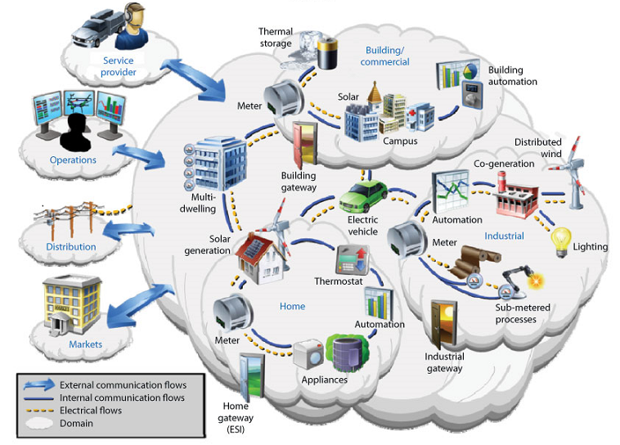
Example: electrical vehicle ecosystem (1/2)
4
Let us take the example of the electrical vehicle ecosystem
The problem to solve is to define its dissemination strategy within a territory
Elements of systems architecture
Notes:
12/09/2021
47

Slide 48

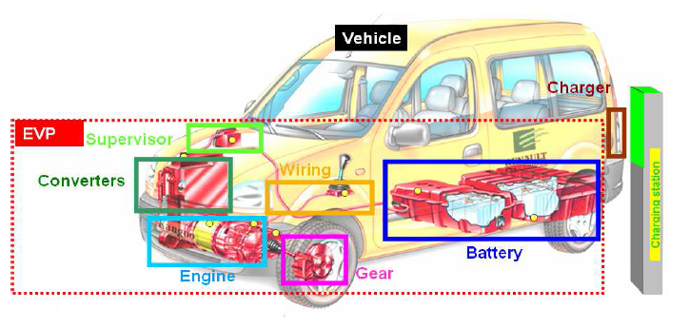
Example: electrical vehicle ecosystem (2/2)
4
Environment & Infrastructure
Roads, garages, rain, etc.
Authorities
Safety regulations,
driving laws, etc.
Electrical car
constructors
Electrical vehicles
Customers
Users, passengers, buyers, owners, etc.
Energy suppliers
Charging stations, batteries, electricity distributors, etc.
Information & communication systems
Telecoms operators, apps, connected services, etc.
Financial institutions
Leasing companies, banks, insurance companies, etc.
The good win-win “to be” vision can be seen as a Nash equilibrium that can be analyzed by means of game theory techniques appearing naturally in a system of systems context since the different systems composing the system of systems are competing together to capture the end-user value, but rarely used in usual systems engineering.
Elements of systems architecture
Notes:
12/09/2021
48

Slide 49
Table of contents
0
Introduction
Systems architecture motivations
Systems architecture fundamentals
Systems architecture in practice
Selected new trends in systems architecture
  4.1 – Systems of systems engineering
  4.2 – Let us dream a little bit!
Conclusion
1
1
2
3
4
5
Elements of systems architecture
Notes:
Ce chapitre commence par une ouverture sur un exemple hors contexte automobile puis revient au contexte automobile.

Slide 50

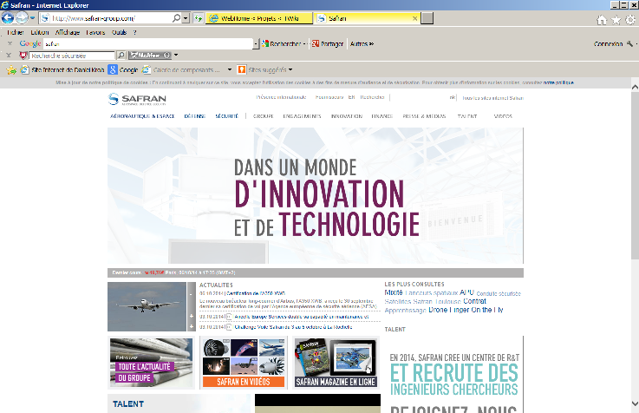

Since 50 years, one knows how to compile a software
4
Interpretation or compilation
Elements of systems architecture
Notes:
12/09/2021
50

Slide 51
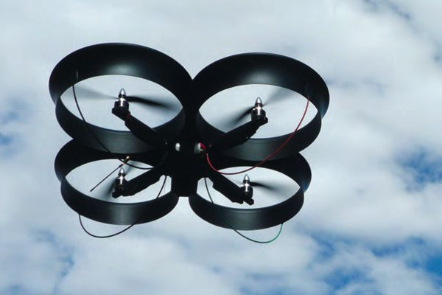
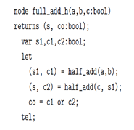
And what if tomorrow, one could synthesize systems?
4
3D printer
Synthesis
Elements of systems architecture
Notes:
12/09/2021
51

Slide 52
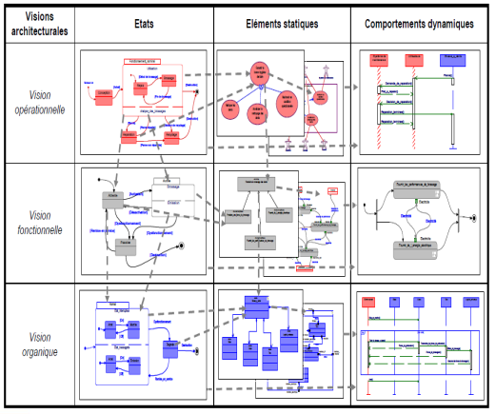

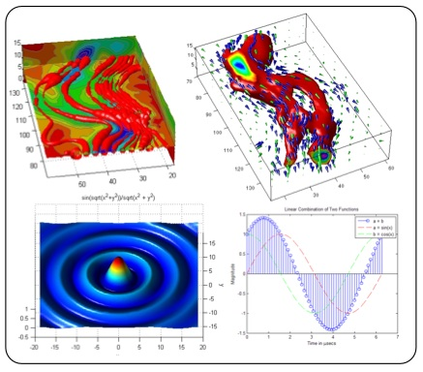
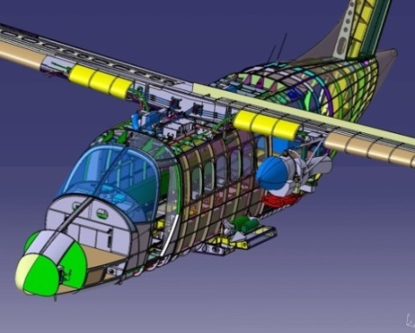
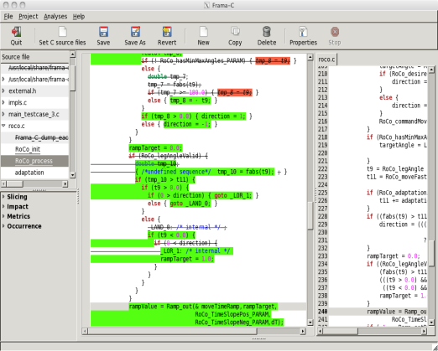
What functional architecture for a system synthesis tool?
4
System Synthesis
INTEGRATION
LOGICS
“Functional Digital Mockup”
“Functional” modelling
COMPONENTS
Multi-physics modelling
Geometric
modelling
Embedded systems modelling
Elements of systems architecture
Notes:
12/09/2021
52

Slide 53
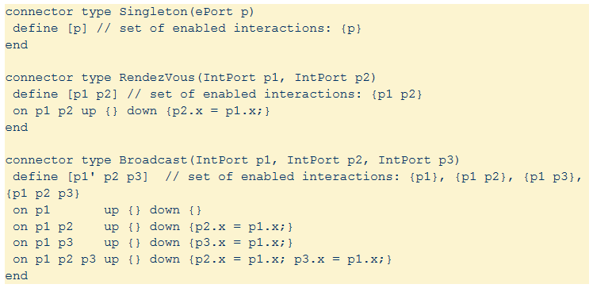
What fundamentals for a system synthesis tool?
4
The central target paradigm: a “system-oriented” programming language, constructed on a rigorous systemic semantics, allowing to specify a system in a completely non-ambiguous way
The target modelling activity: a “programming” process for a system, seen as an abstract machine managing and transforming multi-scale physical, data and informational flows along a multi-scale discrete time.
Example of the first steps toward a system-oriented language (BIP – Joseph Sifakis)
Elements of systems architecture
Notes:
12/09/2021
53

Slide 54
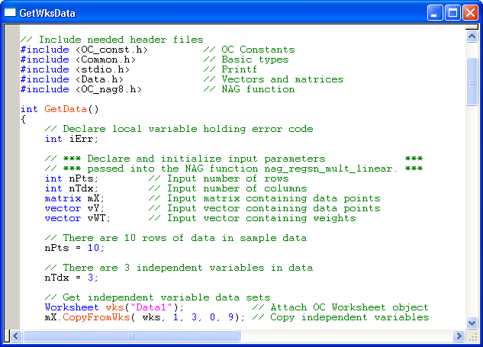
The scientific issue to solve (1/2)
4
Denotational semantics:
Logical syntax describing the mathematical object (function) associated with a program
Program
Equivalence theorems
(that guarantee that the program execution is the one which is described by its syntax)
Operational semantics:
Logical syntax describing the dynamics of the program (i.e. what is doing the program)
Syntax
Elements of systems architecture
Notes:
12/09/2021
54

Slide 55
The scientific issue to solve (2/2)
4
Denotational semantics
Logical syntax describing the mathematical object (formal system) associated with a system
System
Equivalence theorems?
(that guarantee that the system execution is the one which is described by its syntax)
Operational semantics?
Logical syntax describing the dynamics of the system (i.e. what is doing the system)
Syntax?
Elements of systems architecture
Notes:
12/09/2021
55

Slide 56
Table of contents
0
Introduction
Systems architecture motivations
Systems architecture fundamentals
Systems architecture in practice
Selected new trends in systems architecture
Conclusion
1
1
2
3
4
5
Elements of systems architecture
Notes:
Ce chapitre commence par une ouverture sur un exemple hors contexte automobile puis revient au contexte automobile.

Slide 57

A key role: the systems architect
5
1 – Architects definitely have a technical profile:
  They want to complete everything they start
  They have a rigorous & analytical position and can “drill down” when necessary
  They work in well-defined perimeters
  They are business & short-tem-oriented
2 – But good architects think different from many engineers:
  They look beyond the system boundary
    They are receptive to commercial, political and cultural aspects
    They think « solutions » and « stakeholders »
    They always keep in mind the big picture
  They know modeling and innovation
    They develop mental visualization capabilities
    They can navigate through different design levels
    They push innovation, while staying in logical and constrained frameworks
  They help organizations select balanced trade-offs
    They tolerate ambiguity & combine their left and right-brain skills
    They are communicators and facilitate decision-making
    They manage system risks
Elements of systems architecture

Slide 58


C.E.S.A.M.E.S. INSTITUT
Limited Company registered in Paris under RCS 529 638 314
Legal Address: 15, rue La Fayette – 75009 PARIS – France
Contact: contact@cesames.net
Phone: +33 (0)1 40 15 54 20
Architecting a complex world
© C.E.S.A.M.E.S. INSTITUT

